Slide 1
P2
Kurt Burgess

Slide 2
Advertising
We have different types of advertising to cover all forms of media including:
Advertising
Personal Selling
Promotional Activity
Direct Marketing
Sponsorship
PR and Networking
Some are more useful than others, for example TV advertising will get more customers than email spamming.

Slide 3
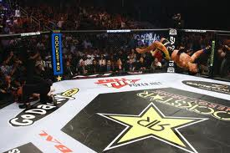
Sponsoring:
GoDaddy.com: They have their logo in the MMA fighting rings when the fights are televised. This is successful as anyone watching will see the logo televised on TV.
I will not do this as I will not be able to cope with the high demand from customers who watch the MMA fights.

Slide 4

Personal Selling Word of Mouth:
The Car Phone Warehouse: They talk on a 1 to 1 basis with the customer to persuade them to buy their product. This is successful as they spend a few minutes explaining in detail what the pros of the product.
I will not do this because it will take too much time to convince the customer, this is not effective means for my company.

Slide 5
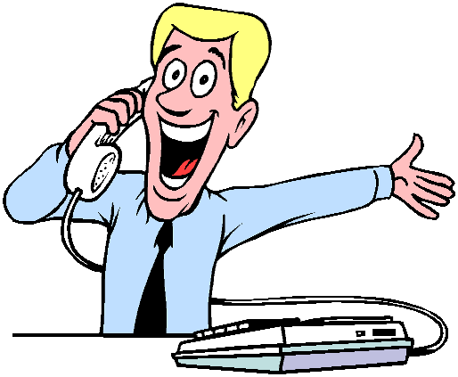
Direct Marketing Phone Calls:
BT: They call up people asking if they are happy with the package and provider they have, then ask if they would like to change to BT. This is successful because you are approached by BT so they are ready to offer a deal.
I will do this, calling up people asking if they want a website with me.

Slide 6
Public Relations:
What is the impact of publicity has on a business:
We use publicity to draw attention to businesses or a product to try and get it into the buyers minds.

Slide 7
Good and Bad Public Relations:
Good: A museum said there was a check for £8000 hidden in the museum with no name on it, so anyone could cash it in. This is good as it brought allot of people into the museum.
Bad : Horse meat was found is some of Tesco’s products, this is bad but they have announced that are taking some products off their shelves.

Slide 8
Celebrity Endorsement:
What is celebrity endorsement?
When a celebrity puts their name to a product, this could be bad as the celebrity could make a fool of themselves and ruin then reputation of the product.

Slide 9
Good and Bad celebrity endorsement
Good: Vinnie Jones was a celebrity endorser of Hands-Only CPR, this is good as they themed it to suit his style, he plays the role of the hard-nut which is what they used to their advantage.
Bad: Britney Spears was a celebrity endorser of Pepsi but was replaced when she was caught drinking Coca Cola.

Slide 10
How I will approach publicity:
I will be approaching this by:
Having a car with my logo on it.
Having a memorable jingle

Slide 11
Celebrities' Influences on the public:
Celebrities are among the highest ranking role models for ages 13 to 18.
Many Celebrities influence the public with the way they dress to the perfume they wear. This can be bad as the celebrities can take drugs and the people influenced by them may be inclined to take them as well.

Slide 12
5 Things to do for a successful advert:
To create a successful advert you must:
1) Make it Memorable
2) No offensive Content
3) Make it Short
4) Make it Fast
5) Make it Simple

Slide 13
Worst advertising
Colman's Bull Advert:
I think this advert was bad because the concept was to strange to be memorable, the ideas expressed where random and had no really relationship to the product, the ideas expressed are odd and random and not very good overall.
The acting is bad.

Slide 14
Networking:
Companies network together to share contact info and connect. This can help when the business needs something the other business can offer.
I will plan to network with a graphics business as they could help make the graphics used in my websites.

Slide 15
Summary:
In summary I will:
Advertise my business
I will use public relations to get my business know
I will not create a bad advert and follow my steps to creating a successful advert
Network my business

